Slide 1




NEXT GEN EMPLOYABILITY PROGRAM
Creating a future-ready workforce
Team Members
College Name
Student Name :R.Shajeena
Student ID : au960221104106
Arunachala college of engineering for women

Slide 2

CAPSTONE PROJECT SHOWCASE
Project Title
Car Rentals Application with Django Framework
Abstract | Problem Statement | Project Overview | Proposed Solution | Technology Used | Modelling & Results | Conclusion

Slide 3
Abstract
.
This project aims to develop a user-friendly web application for car rentals using the Django framework. The application will provide a seamless experience for both car rental agencies and customers, facilitating the process of booking, managing, and tracking rental reservations. Key features include user authentication, a comprehensive search and filtering system, secure payment processing, real-time availability updates, and interactive reservation management dashboards. By leveraging Django's powerful capabilities in backend development and its built-in security features, the application ensures robustness and scalability. Additionally, the implementation of responsive design principles will guarantee optimal usability across various devices. Overall, this project endeavors to revolutionize the car rental industry by offering a modern, efficient, and intuitive solution for all stakeholders involved.
Source :

Slide 4
Problem Statement
In present system all booking is work done manually and it takes very hard work to maintain the information of booking and cars. If we want to find which vehicle is available for booking then it takes a lot of time. It only makes the process more difficult and hard. This is why we want to automate the work performed in the car rental management system like generating daily bookings, records of car or cab available for booking, record of routes available, rental charges for cars for every rout, store record of the customer.
Source :

Slide 5
Project Overview
Our goal is to build a user-friendly web application for car rentals using the Django framework. This application will feature secure user authentication, efficient database management, and seamless payment processing. Customers will enjoy an intuitive interface for searching, filtering, and booking rental vehicles, with real-time updates on availability and pricing. Data security and privacy are paramount, with a responsive design ensuring optimal usability across devices. An admin dashboard will empower rental agencies to manage their fleet and reservations efficiently. Through meticulous planning, development, and testing, our project aims to revolutionize the car rental experience for all stakeholders.
Source :

Slide 6
Proposed Solution
.
Our solution automates car rental management, offering a user-friendly platform for customers to easily find available vehicles and make reservations. Real-time updates on availability reduce search time. Automated booking management generates daily bookings, confirms reservations, and handles invoices. Comprehensive vehicle and route management streamline operations. A CRM system maintains customer records securely. Reporting and analytics track performance metrics for optimization. Robust security measures protect data and ensure compliance. The scalable architecture accommodates growth and new features. This automated system enhances efficiency, transparency, and convenience for rental agencies and customers alike.
Source :

Slide 7
Key component:
key component of our car rental management system is the centralized booking system. This component allows customers to efficiently search for available vehicles based on their preferences, such as location, date, vehicle type, and route. By providing a user-friendly interface and real-time availability updates, the centralized booking system streamlines the reservation process, reducing the time and effort required for customers to find and book a rental vehicle. This component plays a crucial role in enhancing the overall user experience and optimizing the efficiency of the car rental process.
Source :

Slide 8
Benefits:
Efficiency:
Streamlined booking processes and real-time availability updates reduce administrative tasks.
Convenience:
Customers can easily search, book, and receive confirmation details online.
Customer Satisfaction:
Reliable communication channels and optimized resource allocation enhance satisfaction.
Data Insights:
Reporting features provide valuable insights into booking trends and resource utilization.
Source :

Slide 9


Technology Used
Front-end
Back-end
Source :

Slide 10
Modelling & Results
Modeling involves designing a comprehensive data model using Django's ORM for efficient representation of vehicles, customers, reservations, routes, and pricing. Backend development encompasses user authentication, database management, and API implementation. Frontend design focuses on an intuitive interface for vehicle search, booking, and reservation viewing. Real-time updates are integrated through WebSocket or server-sent events. Secure payment processing is ensured through Stripe or PayPal integration. Testing includes unit and integration testing, while deployment involves using platforms like Heroku or AWS. Monitoring tools track performance metrics, and results are evaluated based on KPIs like booking volume, revenue, and customer satisfaction, iterating on feedback for continuous improvement.
Source :

Slide 11
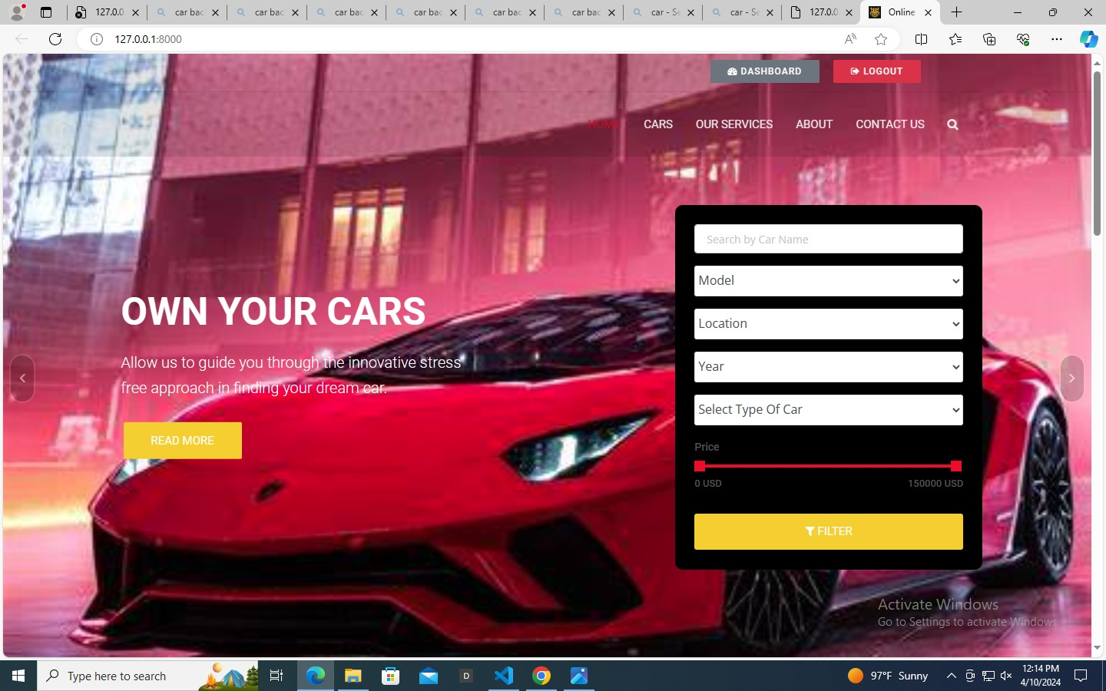
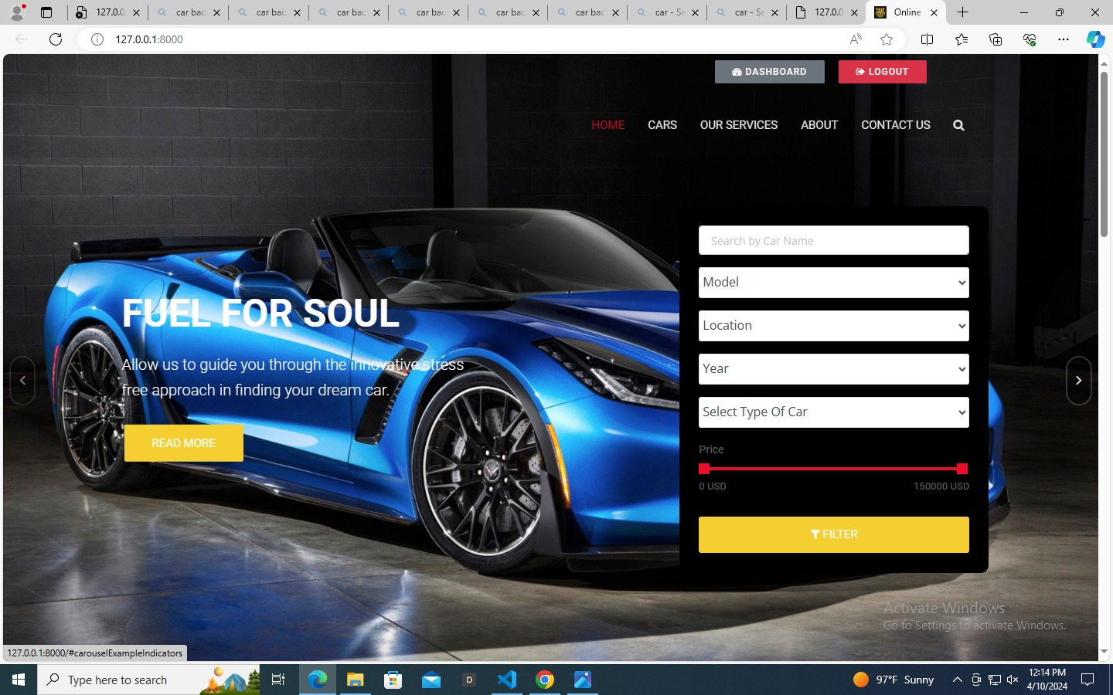
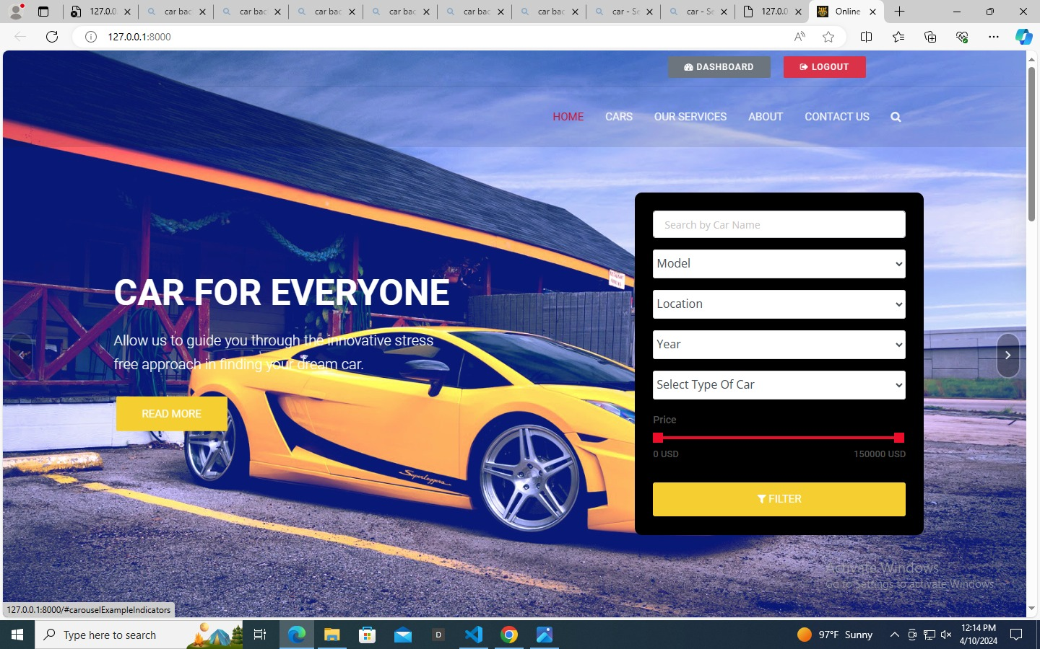
Homepage

Slide 12
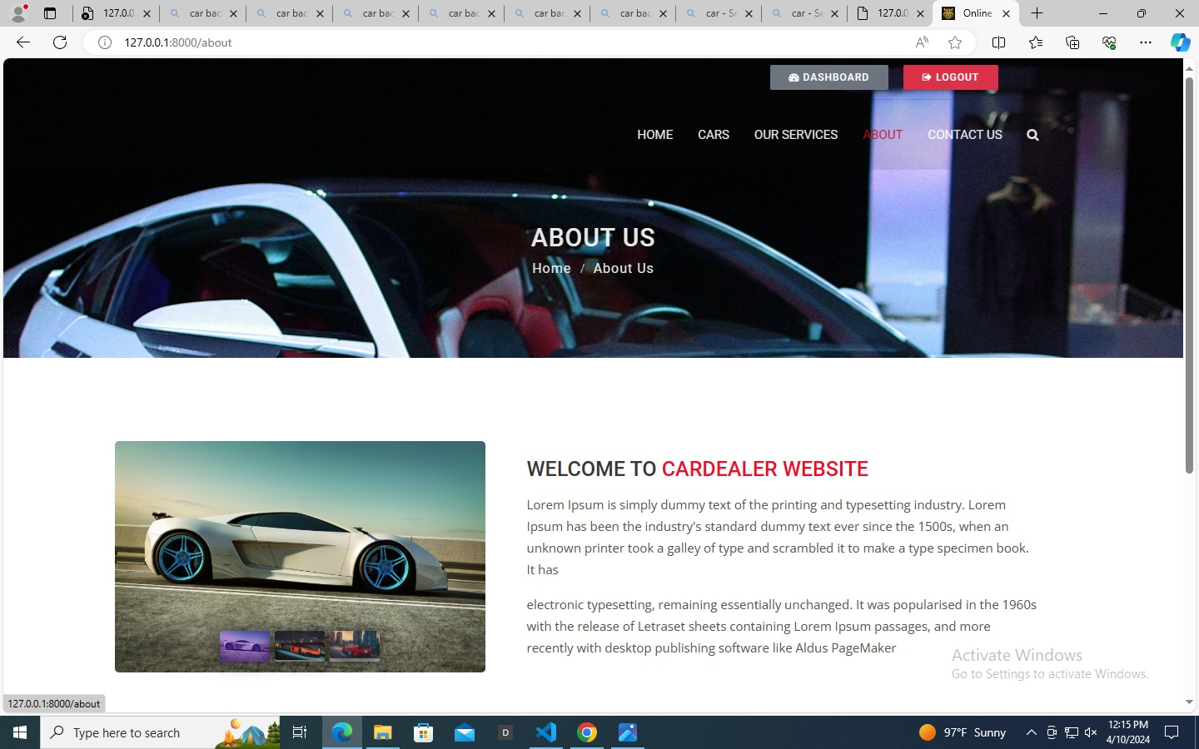
About-Us-Page

Slide 13
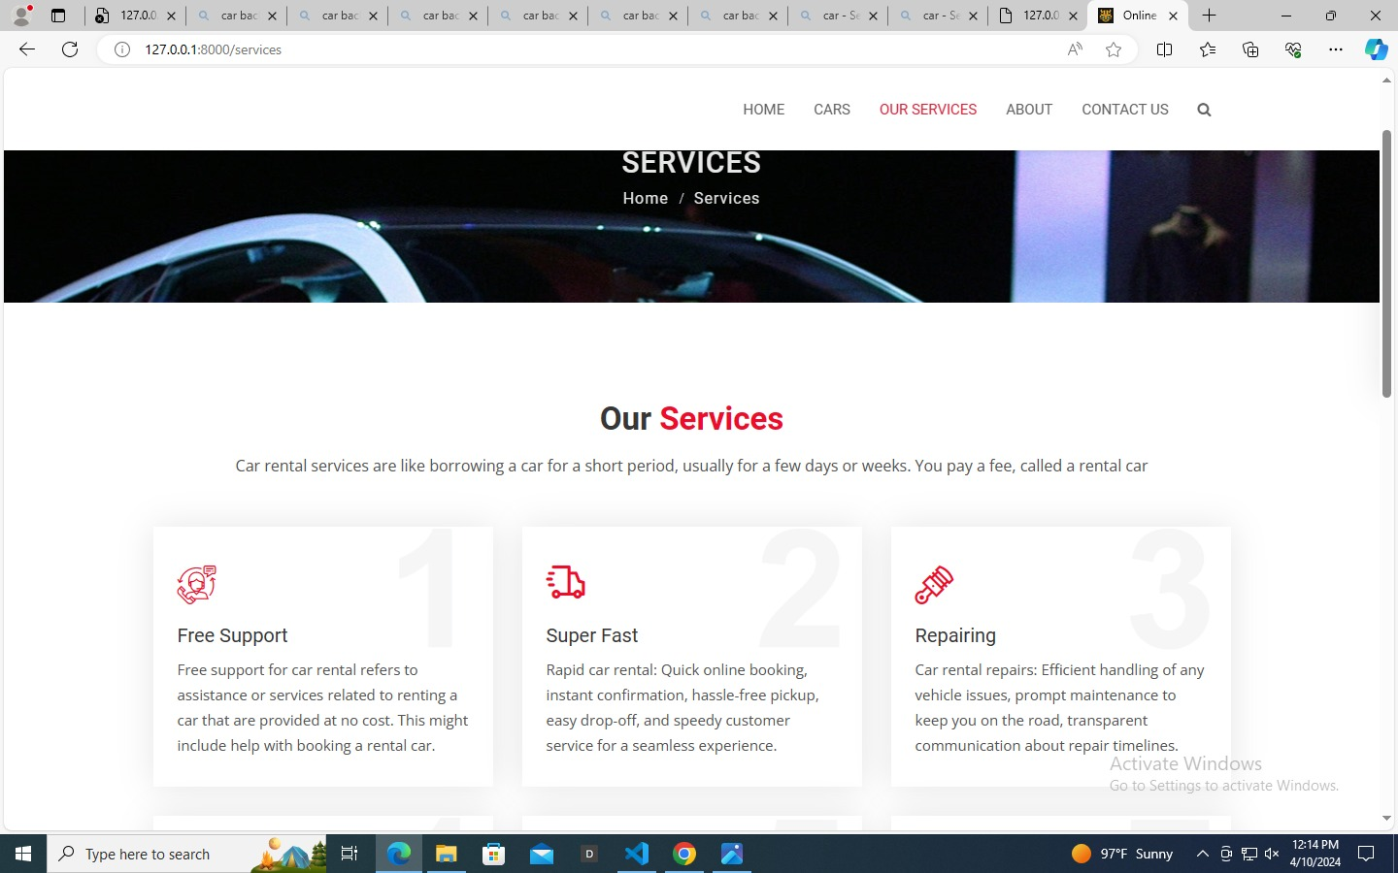
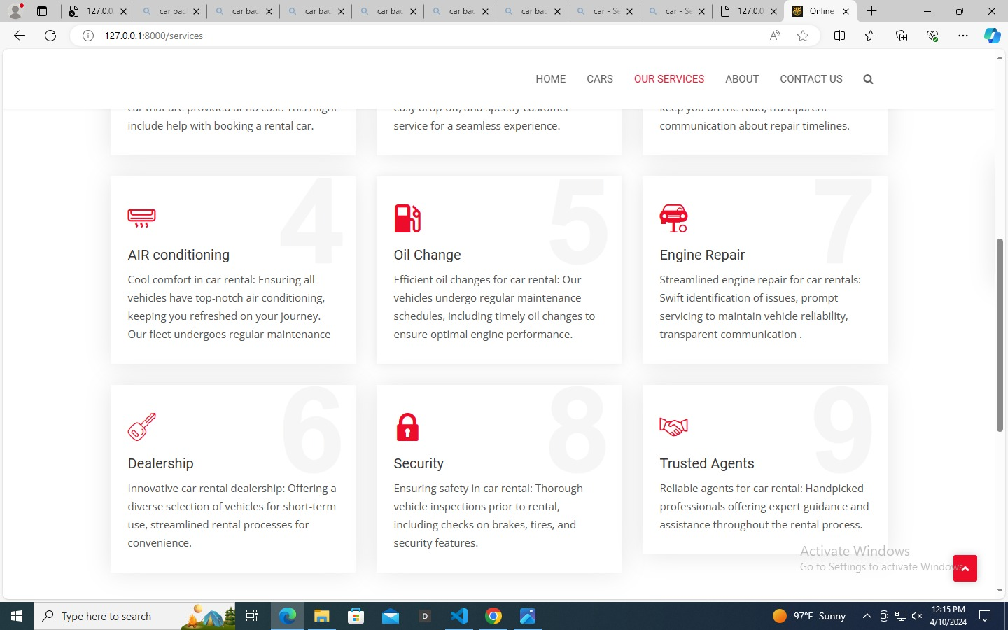
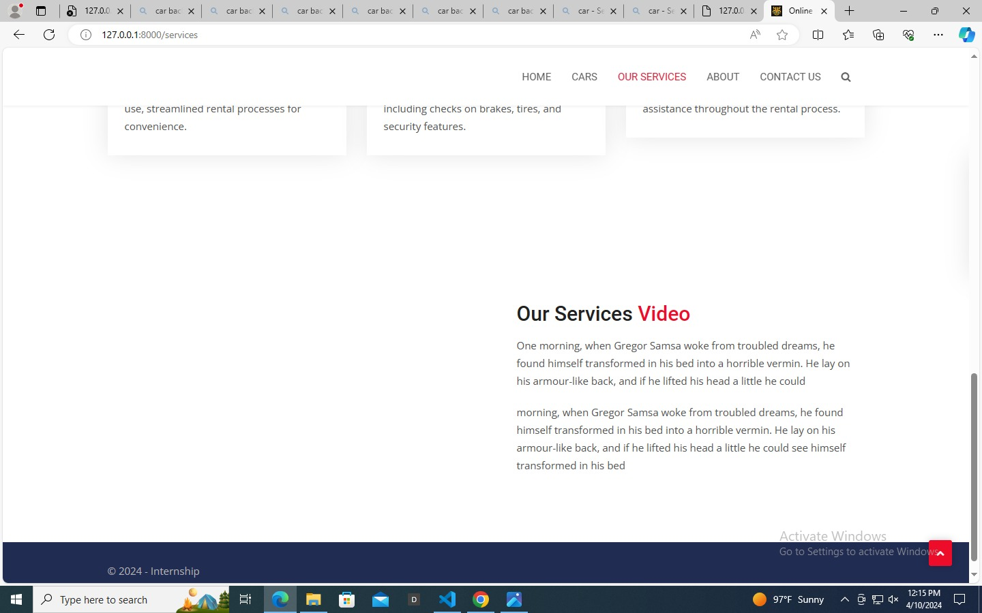
Service-Page

Slide 14
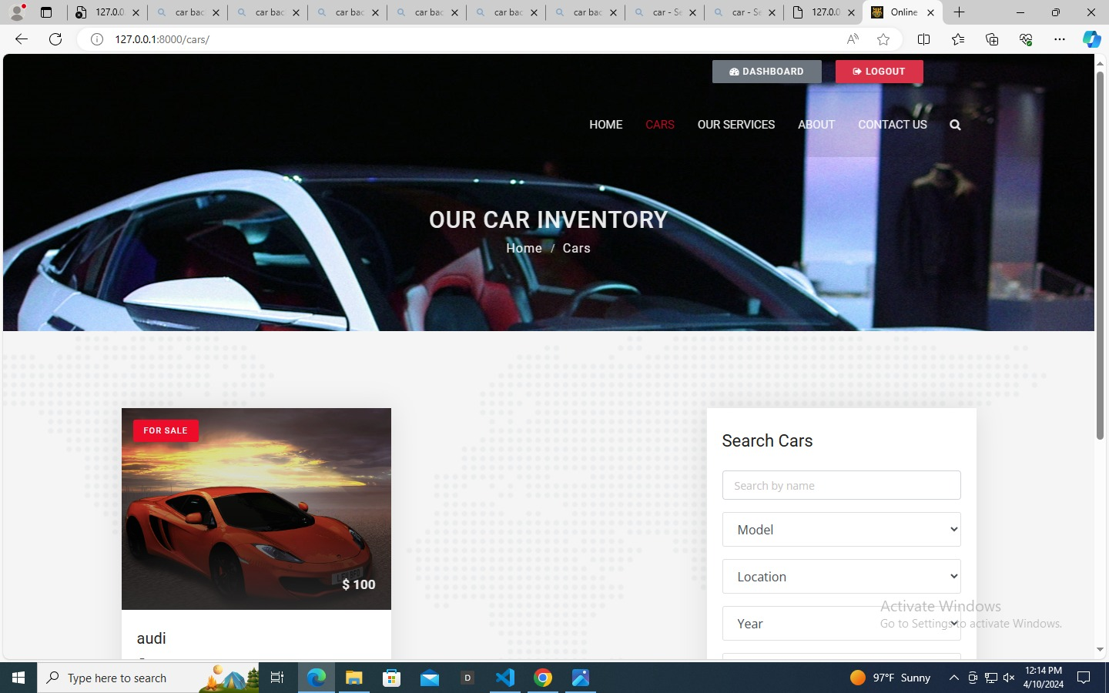
Cars-Page

Slide 15
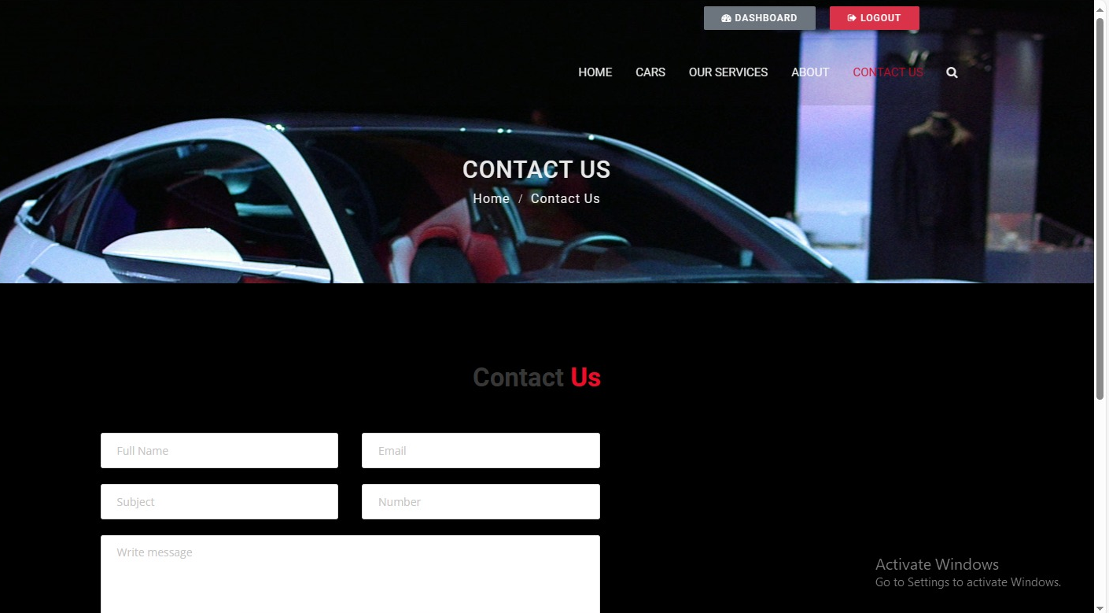
Contact us-Page

Slide 16
Future Enhancements:
In future enhancements, predictive analytics will employ machine learning to forecast demand patterns, optimizing inventory management for rental agencies. Dynamic pricing algorithms will dynamically adjust rental rates based on real-time demand, maximizing revenue potential. Integrating IoT devices into vehicles will provide valuable real-time data for predictive maintenance and fleet optimization. Developing mobile applications for iOS and Android platforms will offer customers a seamless booking experience on smartphones and tablets, enhancing accessibility. Fleet expansion initiatives will introduce electric and luxury vehicles to cater to diverse customer preferences. Collaboration with travel agencies for partnership programs will create bundled packages, expanding market reach and fostering industry relationships. Additionally, blockchain technology will be explored to enhance security and transparency in transactions, ensuring data integrity and customer trust. These future enhancements aim to elevate the car rental experience, offering advanced features and improving overall satisfaction.

Slide 17
Conclusion
Car rental management system presents a comprehensive solution to the challenges faced by the traditional manual booking processes. By leveraging modern technology and innovative approaches, this system streamlines operations, enhances efficiency, and improves the overall customer experience. With features such as real-time availability updates, secure payment processing, and predictive analytics, rental agencies can optimize their resources and maximize revenue potential. Moreover, future enhancements such as dynamic pricing and IoT integration promise further advancements in the industry. Overall, this system represents a significant step towards modernizing and revolutionizing the car rental industry, offering benefits for both agencies and customers alike.
Source :

Slide 18
Thank You!
Notes:
Thank You !!

